Slide 1
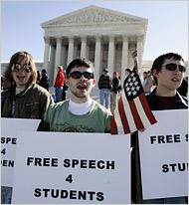
Civil Liberties
From left, Luke Remchuk, Kevin Newcomb and Jay Hartman were among demonstrators for free speech on Monday at the Supreme Court building NYT March 19, 2006
Bong Hits for Jesus Case

Slide 2
Look at all these civil libs cases from last term: http://www.nytimes.com/imagepages/2010/06/30/us/politics/30scotus-graphic.html?ref=supreme_court

Slide 3
Civil Liberties do not equal . . . Civil Rights
Civil liberties are freedoms that are guaranteed to the individual. Civil rights are policies that extend basic rights to groups historically subject to discrimination; Civil liberties are restraints on government. In contrast, civil rights declare what the government must do or provide.

Slide 4
Impact of Federalism
Originally the B of Rights applied only to the fderal gov’t, not the states
Baron v Baltimore 1883- supported that interpretation

Slide 5
Incorporation- 3 views
Total incorporation- all Bill of Rights are nationalized- apply to all of the states
Selective Incorporation- only apply some of the B of Rights to states, on a case by case basis
Supreme Court has taken this approach
Gitlow v New York (1925) upheld a conviction but ruled that states cannot deny freedom of speech and press, which are protected by the “due process” clause of the 14th amendment
Remember 14th Amendment- Civil War Amenments- settled the issue of states rights vs the national government
Palko v Connecticut- test: any right that is so important that liberty can’t exist without it must be upheld by the states.
Disincorporation- argues that the Bill of Rights doesn’t apply to the states

Slide 6
Remember. . . The original Constitution has several civ liberties protections . . . The framers thought they were done. . . Since after all, all state const. protected citizens from gov’t with their own civ libs protections.
Notes:
Therefor answer to quiz q was that it had to be the First Congress NOT thr framers who added the b of rts

Slide 7
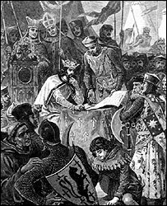
_______ _________is Latin for "you may have the body" (subject to examination). It is a writ which requires a person detained by the authorities be brought before a court of law so that the legality of the detention may be examined. . . . It does not determine guilt or innocence, merely whether the person is legally imprisoned.
King John's clash with the barons strengthened the rights of habeas corpus
A _______ of _________ is a legislative act that singles out an individual or group for punishment without a trial.
Notes:
Habeas corpus
http://news.bbc.co.uk/2/hi/uk_news/magazine/4329839.stm

Slide 8
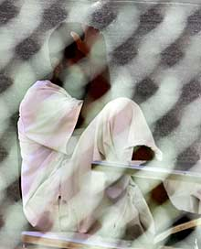
You may not have the body
The Economist Oct 2006
AFTER more than three weeks of wrangling with enemies and allies alike in Congress, President George Bush on September 29th at last won approval for the legislation on terrorist detainees that he says is vital to save American lives. But it is unlikely to improve America's image around the world much. Not only does it permit the CIA to continue its harsh interrogation of suspected terrorists in secret prisons abroad, it also strips foreign detainees of one of the civilized world's most ancient legal protections—the right to challenge their detention in court
Notes:
http://www.economist.com/world/na/displaystory.cfm?story_id=8001555
Even some Republicans were appalled, particularly by the suspension of habeas corpus.

Slide 9
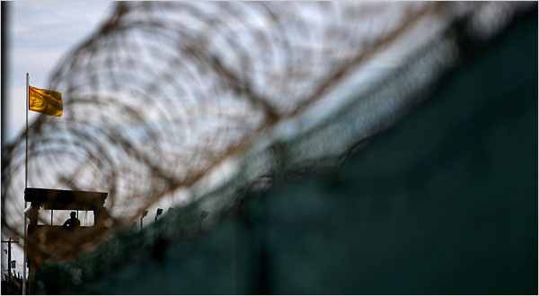
The Guantánamo Bay naval base in Cuba.
WASHINGTON — Foreign terrorism suspects held at the Guantánamo Bay naval base in Cuba have constitutional rights to challenge their detention there in United States courts, the Supreme Court ruled, 5 to 4, on Thursday in a historic decision on the balance between personal liberties and national security.“The laws and Constitution are designed to survive, and remain in force, in extraordinary times,” Justice Anthony M. Kennedy wrote for the court.
The 2006 Military Commission Act stripped the federal courts of jurisdiction to hear habeas corpus petitions filed by detainees challenging the bases for their confinement. That law was upheld by the United States Court of Appeals for the District of Columbia Circuit in February 2007. The ruling on Thursday focused in large part on the centuries old writ of habeas corpus (“you have the body,” in Latin), a means by which prisoners can challenge their incarceration. Noting that the Constitution provides for suspension of the writ only in times of rebellion or invasion, Justice Kennedy called it “an indispensable mechanism for monitoring the separation of powers.”

Slide 10
The ruling came in the latest battle between the executive branch, Congress and the courts over how to cope with dangers to the country in the post-9/11 world. Although there have been enough rulings addressing that issue to confuse all but the most diligent scholars, this latest decision, in Boumediene v. Bush, No. 06-1195, may be studied for years to come. . . .
President Bush, speaking in Rome at a news conference with Prime Minister Silvio Berlusconi of Italy, said: “We’ll abide by the court’s decision. That doesn’t mean I have to agree with it. It was a deeply divided court, and, I strongly agree with those who dissented.” The president said the administration would work with Congress to see what measures could be devised to deal with the detainees. The issues that were weighed in Thursday’s ruling went to the very heart of the separation-of-powers foundation of the United States Constitution. “To hold that the political branches may switch the Constitution on or off at will would lead to a regime in which they, not this court, say ‘what the law is,’ ” Justice Kennedy wrote, citing language in the 1803 ruling in Marbury v. Madison, in which the Supreme Court articulated its power to review acts of Congress.
Joining Justice Kennedy’s opinion were Justices John Paul Stevens, Stephen G. Breyer, Ruth Bader Ginsburg and David H. Souter. Writing separately, Justice Souter said the dissenters did not sufficiently appreciate “the length of the disputed imprisonments, some of the prisoners represented here today having been locked up for six years.”
The dissenters were Chief Justice John G. Roberts Jr. and Justices Samuel A. Alito Jr., Antonin Scalia and Clarence Thomas, generally considered the conservative wing on the high court
Notes:
That’s legitimacy

Slide 11
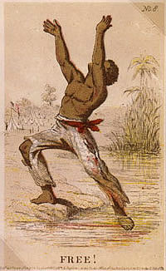
When it comes to the states: most civil liberties (and civil rights) derive from the Fourteenth Amendment
One of the three “Civil War Amendments”
.

Slide 12
But the civil liberties are guaranteed by one clause; civil rights granted by another:
No state shall make or enforce any law which shall abridge the privileges or immunities of citizens of the United States; nor shall any state deprive any person of life, liberty, or property, without due process of law; nor deny to any person within its jurisdiction the equal protection of the laws

Slide 13
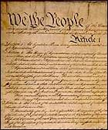
Questions about the 14th Amendment
What’s due process?
Substantive vs Procedural Due Process
the Due Process Clause of the Fourteenth Amendment ,
states "nor shall any State deprive any person of life, liberty, or property, without due process of law”

Slide 14
What is the facially plain meaning of the words deprive any person of life, liberty, or property, without due process of law”
a state has to use sufficiently fair and just legal procedures whenever it is going to lawfully take away a persons life, freedom or possessions.
before a man can be executed, imprisoned or fined for a crime, he must get a fair trial, based on legitimate evidence, with a jury, etc.
These are procedural or "process" rights, like the ones Congress has to abide by in the ______ of ________

Slide 15
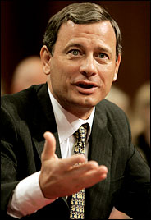
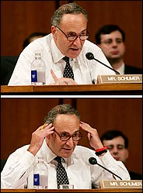
Substantive Due Process
The doctrine of Substantive Due Process holds that the Due Process Clause not only requires "due process," that is, basic procedural rights, but that it also protects basic substantive rights
not enough that govt. use fair procedures in denying life, liberty, and property; the law themselves that enable govt. to do so must be fair—if the govt takes away life, lib or property, it must have appropriate justification to do so.
Regardless of the procedures

Slide 16
So . . .
Substantive rights are basic rights that give a person the power to have or to do specific things, even though the government wants something different-- Court roots them in the key phrase “liberty” –found thru incorporation or b/c so “fundamental
"Procedural" rights are special rights that, instead, dictate how the government can lawfully go about taking away a person’s freedom or property or life, when the law otherwise gives them the power to do so.

Slide 17
Examples
Police strip searches
Procedural
Minimum wage law
Substantive
Possession of marijuana for medical purposes
Substantive
Police have to have a warrant before they grab it
Procedural
Burning the flag
substantive

Slide 18
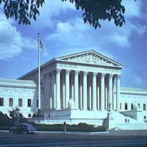
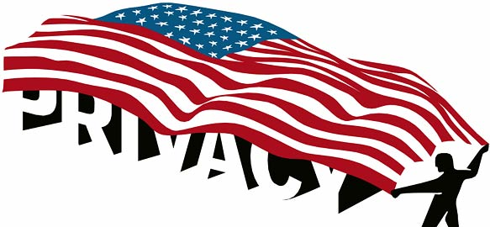
Substantive are much more controversial.
not the facially clear meaning of the DP passage in the Const.—
it greatly expands the power of judicial review
Especially when they find rights not explicitly in the Constitution

Slide 19
And then eek . . . Apply them to the states through the process of _______ _________

Slide 20
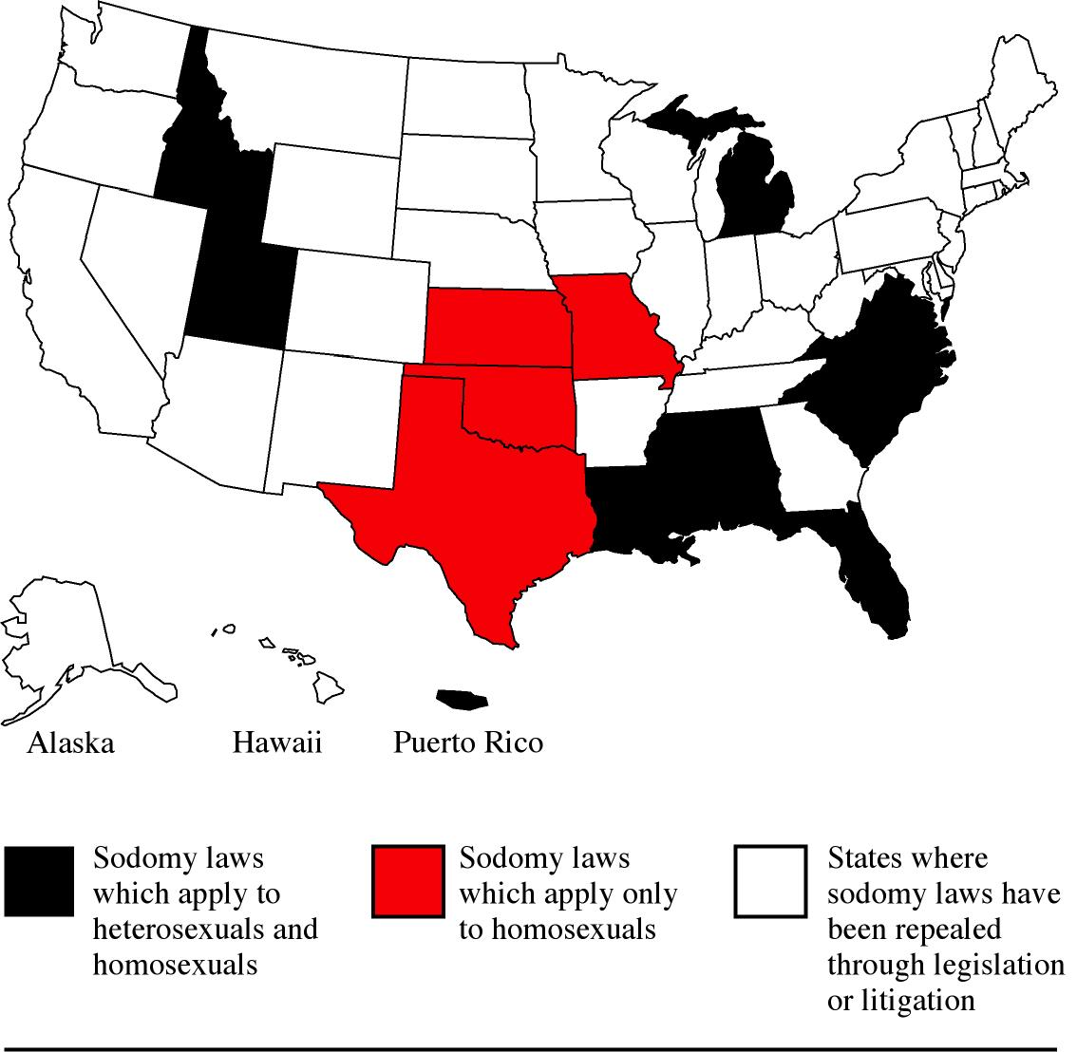
Lawrence v Texas (2003)
To illustrate Civil libs vs civil rts
Facts of the Case
Responding to a reported weapons disturbance in a private residence, Houston police entered John Lawrence's apartment and saw him and another adult man, Tyron Garner, engaging in a private, consensual sexual act. Lawrence and Garner were arrested and convicted of deviate sexual intercourse in violation of a Texas statute forbidding two persons of the same sex to engage in certain intimate sexual conduct. In affirming, the State Court of Appeals held that the statute was not unconstitutional under the Due Process Clause of the Fourteenth Amendment, with Bowers v. Hardwick, 478 U.S. 186 (1986), controlling.
Notes:
http://www.google.com/imgres?imgurl=http://www.glapn.org/sodomylaws/lawrence/RUCfordLTR.jpg&imgrefurl=http://www.glapn.org/sodomylaws/lawrence/lawrence.htm&usg=__Qot9qSbf7Pl2kl6okHUqEdkvGbU=&h=1206&w=813&sz=185&hl=en&start=29&zoom=1&itbs=1&tbnid=EsMoI9zqiIdvjM:&tbnh=150&tbnw=101&prev=/images%3Fq%3Dtexas%2Bvs%2Blawrence%26start%3D20%26hl%3Den%26safe%3Dactive%26sa%3DN%26gbv%3D2%26ndsp%3D20%26tbs%3Disch:1 has acutal statue

Slide 21
Question
Do the criminal convictions of John Lawrence and Tyron Garner under the Texas "Homosexual Conduct" law, which criminalizes sexual intimacy by same-sex couples, but not identical behavior by different-sex couples, violate the Fourteenth Amendment guarantee of equal protection of laws? Do their criminal convictions for adult consensual sexual intimacy in the home violate their vital interests in liberty and privacy protected by the Due Process Clause of the Fourteenth Amendment? Should Bowers v. Hardwick, 478 U.S. 186 (1986), be overruled?

Slide 22
Conclusion
No, yes, and yes. In a 6-3 opinion delivered by Justice Anthony M. Kennedy, the Court held that the Texas statute making it a crime for two persons of the same sex to engage in certain intimate sexual conduct violates the Due Process Clause. After explaining what it deemed the doubtful and overstated premises of Bowers, the Court reasoned that the case turned on whether Lawrence and Garner were free as adults to engage in the private conduct in the exercise of their liberty under the Due Process Clause. "Their right to liberty under the Due Process Clause gives them the full right to engage in their conduct without intervention of the government," wrote Justice Kennedy. "The Texas statute furthers no legitimate state interest which can justify its intrusion into the personal and private life of the individual," continued Justice Kennedy. Accordingly, the Court overruled Bowers. Justice Sandra Day O'Connor filed an opinion concurring in the judgment. Justices Clarence Thomas and Antonin Scalia, with whom Chief Justice William H. Rehnquist and Justices Thomas joined, filed dissents
Majority:Stevens, O’Conner, Kennedy, Ginsberg Souter, Breyer (not picutered)
Minority: Rehnquist,Scalio, Thomas
Rehnquist
Stevens
O'Connor
Scalia
Kennedy
Souter
Thomas
Ginsburg

Slide 23
So let’s take a look at some of those substantive first amendment Liberties
Remember—there are five and they are:
Religion, Speech, Press, Assembly, Petition
Congress shall make no law respecting an establishment of religion, or prohibiting the free exercise thereof; or abridging the freedom of speech, or of the press; or the right of the people peaceably to assemble, and to petition the government for a redress of grievances.
They are not absolute . . . but if the government is going to infringe on these liberties it must show it has a
Compelling state interest

Slide 24
Worried about the Feds?
Check the 5th amendment: No person shall . . . be deprived of life, liberty, or property, without due process of law; nor shall private property be taken for public use, without just compensation.
SO . . . They can take your property since Govt’s have the right of “Eminent domain” . . (power of the state to expropriate private property without the owner's consent for public use (eg public utilities or roads or railroads)
But it is subject to this “takings clause”

Slide 25
Freedom of Religion
Note there are TWO clauses
The Establishment Clause: CONGRESS shall make no law respecting an establishment of religion
. . . or prohibiting the free exercise thereof
The “Free Exercise” clause and the “Establishment Clause”

Slide 26
Two views about the Establishment clause:
Accomodationist View" government should bend a bit and allow a certain degree of church/state blending--e.g moment of silence
Separationist View--Government should allow no blending of church and state. There should be a "wall of separation” (TJ)
The Rehnquist court has become more accomodationist—allowing “chinks” in the wall
The Burger court had said essentially a law must have a secular purpose and can not advance nor inhibit a relgion, nor entangle the state in religion
Rehnquist court said that a law which provides public aid is ok as long as it does not 'endorse" a particular religion and avoids any religious content

Slide 27
Free Exercise Clause
Distinction between belief and practice
At issue is often the states’ need to regulate for the health and welfare of its citizens (compelling state interest) versus an individual’s right to practice religion . . . It’s a balancing act
Note these all involve some question of whether the gov’t can regulate some kind of practice, just as the est. clause was whether gov’t could est a religion—NOT private restrictions or private churches

Slide 28
There are TWO elements to the religions liberty
Congress shall make no law respecting an establishment of religion, or prohibiting the free exercise thereof;
The first is known as the __________ clause
The second . . . The ______ _________
clause
Notes:
The Burger Court continued to apply this test, using it in 1972 to find unconstitutional (as applied to Amish families) Wisconsin's law mandating attendance in schools until age 17 (Yoder

Slide 29
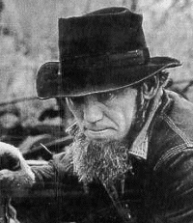
Let’s apply the law:
Jonas Yoder and Wallace Miller, both members of the Old Order Amish religion, and Adin Yutzy, a member of the Conservative Amish Mennonite Church, were prosecuted under a Wisconsin law that required all children to attend public schools until age 16. The three parents refused to send their children to such schools after the eighth grade, arguing that high school attendance was contrary to their religious beliefs. 1972
Free exercise or establishment clause?
Jonas Yoder, who challenged Wisconsin's compulsory education law (LIFE).
Notes:
Free excercise

Slide 30
In a 6-to-1 decision, the Court held that individual's interests in the free exercise of religion under the First Amendment outweighed the State's interests in compelling school attendance beyond the eighth grade. The Court found that the values and programs of secondary school were "in sharp conflict with the fundamental mode of life mandated by the Amish religion," and that an additional one or two years of high school would not produce the benefits of public education cited by Wisconsin to justify the law.
So no compelling state interest- precedent required to limit free exercise from Employment
Division v Smith 1990 Rehnquist

Slide 31
Facts: Two Native Americans who worked as counselors for a private drug rehabilitation organization, ingested peyote -- a powerful hallucinogen -- as part of their religious ceremonies as members of the Native American Church. As a result of this conduct, the rehabilitation organization fired the counselors. The counselors filed a claim for unemployment compensation. The government denied them benefits because the reason for their dismissal was considered work-related "misconduct" which violated state drug laws which prohibited the consumption of illegal drugs, even for sacramental religious uses.
Free exercise or establishment?

Slide 32
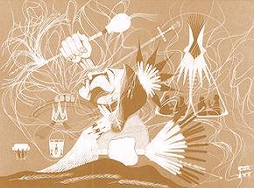
Issue:
Does the state law violate the Free Exercise Clause of the First Amendment?
"Morning Peyote" by Rance Hood (1969)
Notes:
Sect Allowed to Import Its Hallucinogenic Tea http://www.nytimes.com/2006/02/22/politics/22scotus.html?pagewanted=2

Slide 33
No. Justice Scalia, writing for the majority, observed that the Court has never held that an individual's religious beliefs excuse him from compliance with an otherwise valid law prohibiting conduct that government is free to regulate. Allowing exceptions to every state law or regulation affecting religion "would open the prospect of constitutionally required exemptions from civic obligations of almost every conceivable kind." Scalia cited as examples compulsory military service, payment of taxes, vaccination requirements, and child-neglect laws.
So the state had a compelling state interest, and their law did not target a religion Employment division vs Smith

Slide 34
Sante Fe School District vs Doe (2000)
Facts: A School district policy permitted, but did not require, student-initiated and student-led prayer at all the home games and authorized two student elections, the first to determine whether "invocations" should be delivered at games, and the second to select the spokesperson to deliver them. After the students authorized such prayers and selected a spokesperson, the District Court entered an order modifying the policy to permit only nonsectarian, nonproselytizing prayer. The Court of Appeals held that, even as modified by the District Court, the football prayer policy was invalid. The District petitioned for a writ of certiorari
Establishment or free exercise?

Slide 35
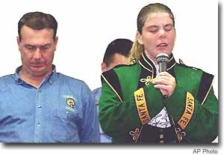
At
Issue?
Santa Fe High School senior Marian Ward, 18, delivers prayer before football game against Texas City on Oct. 8 in Santa Fe, Texas. At left: Gary Causey, Santa Fe High School principal.
Does the Santa Fe Independent School District's policy permitting student-led, student-initiated prayer at football games violate the Establishment Clause of the First Amendment?

Slide 36
Yes. In a 6-3 opinion delivered by Justice John Paul Stevens, the Court held that the District's policy permitting student-led, student-initiated prayer at football games violates the Establishment Clause. The Court concluded that the football game prayers were public speech authorized by a government policy and taking place on government property at government-sponsored school-related events and that the District's policy involved both perceived and actual government endorsement of the delivery of prayer at important school events. Such speech is not properly characterized as "private," wrote Justice Stevens for the majority. In dissent, Chief Justice William H. Rehnquist, joined by Justices Antonin Scalia and Clarence Thomas, noted the "disturbing" tone of the Court's opinion that "bristle[d] with hostility to all things religious in public life."

Slide 37
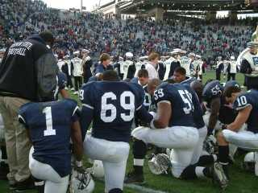
Schools Bow Head in Defiance
August 28, 2000 CSM
The pre-game ceremony at the Batesburg-Leesville High School football stadium is straightforward.
The playing of the national anthem. The presentation of the American flag by the Junior ROTC. The offering of a prayer by a student. And then the kickoff.
They've done it this way for generations. And last Friday, the South Carolina school sent a message over its loudspeaker that they're going to keep praying - testing the limits of a recent US Supreme Court ruling that student-led prayer at high school football games violates the Constitution.

Slide 38
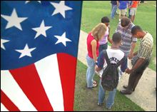
What’s different about this?

Slide 39
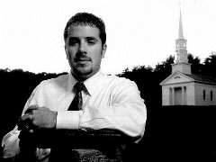
If a state provides college scholarships for secular instruction, does the First Amendment's free exercise clause require a state to fund religious instruction?
Joshua Davey (American Bar Journal photo)

Slide 40
The State of Washington, like many other states, has a provision in its Constitution that prohibits the use of public money for religious instruction. The state turned down an application for a scholarship from an otherwise eligible student who sought a theology degree at a private Christian college. Washington makes state scholarships available for use at accredited religious colleges, as long as the money is not used to pursue a degree in theology. The policy, embodied in a state law as well as the Washington Constitution, was challenged in 1999 by Joshua Davey, a student at Northwest College, in Kirkland, near Seattle, where he was seeking a degree in pastoral ministries. A federal district court ruled that while the state could not prevent Mr. Davey from pursing religious studies, it was under no obligation to fund him. The Ninth Circuit overturned that decision, ruling 2 to 1 that the state scholarship program had established a "fiscal forum," much as a government might establish a public forum for free speech

Slide 41
No. In a 7-2 opinion delivered by Chief Justice William Rehnquist, the Court ruled that a state does not violate the First Amendment's free exercise clause when it funds secular college majors but excludes devotional theology majors. The Court rejected Davey's argument that the state scholarship program is unconstitutional because it is not neutral toward religion. "The State has merely chosen not to fund a distinct category of instruction," the Court wrote. Similarly the Washington Constitution - which explicitly prohibits state money from going to religious instruction - does not violate the free exercise clause. Unlike laws and programs the Court has struck down under the free exercise clause, nothing in either the scholarship program or the state constitution "suggests animus towards religion." States have a "historic and substantial interest" in excluding religious activity from public funding.

Slide 42
Facts: A High school authorized after school clubs, and allowed them to meet after school. It denied the right for an evangelical Christian group to meet. The school board had argued that permitting the club to meet would be an unconstitutional endorsement of religion by the school
Issue:
violation of free exercise to NOT let met or establishment clause to let meet?

Slide 43
Question
Did Milford Central School violate the First Amendment free speech rights of the Good News Club when it excluded the Club from meeting after hours at the school? If a violation occurred, was it justified by Milford's concern that permitting the Club's activities would violate the Establishment Clause?
Conclusion
Yes and no. In a 6-3 opinion delivered by Justice Clarence Thomas, the Court held that "Milford's restriction violates the Club's free speech rights and that no Establishment Clause concern justifies that violation." "When Milford denied the Good News Club access to the school's limited public forum on the ground that the Club was religious in nature, it discriminated against the Club because of its religious viewpoint in violation of the Free Speech Clause of the First Amendment," wrote Justice Thomas. The dissent argued that it WAS ok to discriminate against a group that was proselytizing.

Slide 44
Facts: Ohio's Pilot Project Scholarship Program provides tuition aid in the form of vouchers for certain students in the Cleveland City School District to attend participating public or private schools of their parent's choosing. Both religious and nonreligious schools in the district may participate. Tuition aid is distributed to parents according to financial need, and where the aid is spent depends solely upon where parents choose to enroll their children. In the 1999-2000 school year 82 percent of the participating private schools had a religious affiliation and 96 percent of the students participating in the scholarship program were enrolled in religiously affiliated schools. Sixty percent of the students were from families at or below the poverty line.
Question Presented
Does Ohio's school voucher program violate the___________ clause?
Notes:
establishment

Slide 45
No. In a 5-4 opinion delivered by Chief Justice William H. Rehnquist, the Court held that the program does not violate the Establishment Clause. The Court reasoned that, because Ohio's program is part of Ohio's general undertaking to provide educational opportunities to children, government aid reaches religious institutions only by way of the deliberate choices of numerous individual recipients and the incidental advancement of a religious mission, or any perceived endorsement, is reasonably attributable to the individual aid recipients not the government. Chief Justice Rehnquist wrote that the "Ohio program is entirely neutral with respect to religion. It provides benefits directly to a wide spectrum of individuals, defined only by financial need and residence in a particular school district. It permits such individuals to exercise genuine choice among options public and private, secular and religious. The program is therefore a program of true private choice."

Slide 46
The Ten Commandments
The justices accepted appeals from two opposing lower-court rulings,
one that upheld the display of a six-foot-high Ten Commandments monument on the grounds of the Texas State Capitol and another that ordered two Kentucky counties to remove framed copies of the Commandments from their courthouse walls.
The Texas Legislature received the Ten Commandments monument in 1961 as a gift from the Fraternal Order of Eagles, an organization that placed thousands of such monuments on public property in the 1950's and 1960's. The organization said the Commandments offered a personal code of behavior that would reduce juvenile delinquency, a stated goal the Fifth Circuit opinion cited as evidence of a lack of religious purpose behind the display.
The Supreme Court has issued only one Ten Commandments decision, a two-page opinion it issued by a 5-to-4 vote in 1980 striking down a Kentucky law that required the posting of a copy of the Commandments in every public school classroom. "

Slide 47
Conclusion on the ones from Kentucky:
In a 5-4 opinion delivered by Justice David Souter, the majority held that the displays violated the establishment clause because their purpose had been to advance religion."

Slide 48
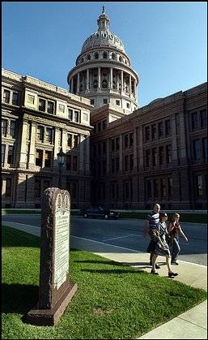
Conclusion on the Texas State Capital case
No. In 5-4 decision, and in a four-justice opinion delivered by Chief Justice William H. Rehnquist, the Court held that the establishment clause did not bar the monument on the grounds of Texas' state capitol building. The plurality deemed the Texas monument part of the nation's tradition of recognizing the Ten Commandments' historical meaning. Though the Commandments are religious, the plurality argued, "simply having religious content or promoting a message consistent with a religious doctrine does not run afoul of the establishment clause."

Slide 49
Tests/standards Court uses to determine if freedom of speech is protected
Preferred position doctrine: right of free expression occupies a higher standard than other rights
Not absolute but Court is skeptical of restrictions
Hate speech is protected
Prior Restraint
Blocking speech before it’s given
Court with few exceptions will not tolerate restrictions with few exceptions

Slide 50
Neutrality
Any restriction on speech cannot favor one group over another (parades/demonstrations)
Ex: National Socialist Party of America v. Village of Skokie
Vagueness- limits on expression must be clear standards
Least Restrictive Means
Laws cannot restrict speech if there is another means to handle the problem,
Fighting Words- must have direct tendency to cause violence
Imminent or Clear and Present Danger
Yelling fire in a theater
Warren Court- imminent danger plus people must be urged to take action, not just believe something

Slide 51
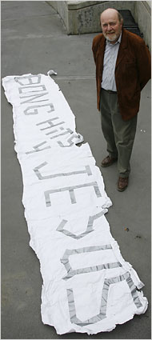
Morse v. Frederick 2007
Background Joseph Frederick unfurled a homemade sign in 2002, as the Olympic torch made its way through Juneau, Alaska, en route to the Winter Olympics in Salt Lake City. Frederick said the banner was a nonsensical message and that he intended the banner to proclaim his right to say anything at all. His principal, Deborah Morse, said the phrase was a pro-drug message that had no place at a school-sanctioned event. Frederick denied that he was advocating for drug use.

Slide 52
Holding: The Court reversed the Ninth Circuit by a 5-4 vote, ruling that school officials can prohibit students from displaying messages that promote illegal drug use. Chief Justice John Roberts's majority opinion held that although students do have some right to political speech even while in school, this right does not extend to pro-drug messages that may undermine the school's important mission to discourage drug use. The majority held that Frederick's message, though "cryptic," was reasonably interpreted as promoting marijuana use - equivalent to "[Take] bong hits" or "bong hits [are a good thing]." In ruling for Morse, the Court affirmed that the speech rights of public school students are not as extensive as those adults normally enjoy, and that the highly protective standard set by Tinker would not always be applied. In concurring opinions, Justice Thomas expressed his view that the right to free speech does not apply to students and his wish to see Tinker overturned altogether, while Justice Alito stressed that the decision applied only to pro-drug messages and not to broader political speech. The dissent conceded that the principal should have had immunity from the lawsuit, but argued that the majority opinion was "[...] deaf to the constitutional imperative to permit unfettered debate, even among high-school students [...]."
The Majority
The Minority
Notes:
2006-2007 term

Slide 53
Bethel School District v. Fraser 1986
Facts: At a school assembly of approximately 600 high school students, Matthew Fraser made a speech nominating a fellow student for elective office. In his speech, Fraser used what some observers believed was a graphic sexual metaphor to promote the candidacy of his friend. As part of its disciplinary code, Bethel High School enforced a rule prohibiting conduct which "substantially interferes with the educational process . . . including the use of obscene, profane language or gestures." Fraser was suspended from school for two days.

Slide 54
Matthew’s speech . . . .
Matthew Fraser gave the following speech at a high school assembly in support of a candidate for student government office: "I know a man who is firm -- he's firm in his pants, he's firm in his shirt, his character is firm -- but most . . . of all, his belief in you, the students of Bethel, is firm.
Jeff Kuhlman is a man who takes his point and pounds it in. If necessary, he'll take an issue and nail it to the wall. He doesn't attack things in spurts -- he drives hard, pushing and pushing untilfinally -- he succeeds.
Jeff is a man who will go to the very end -- even the climax, for each and every one of you.
So vote for Jeff for A. S. B. vice-president -- he'll never come between you and the best our high school can be."

Slide 55
Holding: The Court found that it was appropriate for the school to prohibit the use of vulgar and offensive language. Chief Justice Burger distinguished between political speech which the Court previously had protected in Tinker v. Des Moines Independent Community School District (1969) and the supposed sexual content of Fraser's message at the assembly. Burger concluded that the First Amendment did not prohibit schools from prohibiting vulgar and lewd speech since such discourse was inconsistent with the "fundamental values of public school education."

Slide 56
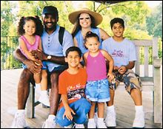
Is cross burning a form of free speech?
HAPPIER TIMES: The Jubilees, shown here in a family photo, found a partially burned cross in front of their Virginia Beach home in 1998
.
The first cases involves two white men, Richard Elliott and Jonathan O'Mara, who attempted to burn a makeshift cross on the lawn of their black neighbor in Virginia Beach. They were angry that the neighbor had earlier complained about their firing weapons in a backyard rifle range. The neighbor, James Jubilee, discovered the partially burned cross in his yard the next morning and called police. Later, he and his family moved to a different town. Mr. O'Mara pleaded guilty to attempted cross burning and was sentenced to 45 days in jail and fined $1,500. Mr. Elliot was convicted at trial and sentenced to 90 days in jail and fined $2,500.The second case involves Barry Elton Black, a Ku Klux Klan member, who conducted a cross burning during a KKK rally on private land in Carroll County. The cross was at least 25 feet tall and could be seen from neighboring homes and a nearby highway. Mr. Black admitted he was responsible for burning the cross and was convicted at trial. He was fined $2,500.
Notes:
http://www.csmonitor.com/2002/1211/p01s01-usju.html

Slide 57
Virginia v Black- 2003
Question
Does the Commonwealth of Virginia's cross-burning statute, which prohibits the burning of a cross with the intent of intimidating any person or group of persons, violate the First Amendment?
Conclusion
Yes, but in a plurality opinion delivered by Justice Sandra Day O'Connor, the Court held that while a State, consistent with the First Amendment, may ban cross burning carried out with the intent to intimidate, in which four other justices joined, the provision in the Virginia statute treating any cross burning as prima facie evidence of intent to intimidate renders the statute unconstitutional in its current form, in which three other justices joined.
Justice David H. Souter, joined by Justices Anthony M. Kennedy and Ruth Bader Ginsburg, concluded that the Virginia statute is unconstitutional and therefore concurred in the Court's judgment insofar as it affirmed the invalidation of Black's conviction. Justice Clarence Thomas dissented.

Slide 58
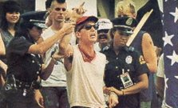
Texas v Johnson 1989
Facts: In 1984, in front of the Dallas City Hall, Gregory Lee Johnson burned an American flag as a means of protest against Reagan administration policies. Johnson was tried and convicted under a Texas law outlawing flag desecration. He was sentenced to one year in jail and assessed a $2,000 fine. After the Texas Court of Criminal Appeals reversed the conviction, the case went to the Supreme Court.
Gregory Johnson outside the 1984 Republican National Convention
Issue presented?
Is symbolic speech protected? Is this political speech and so deserving of extra protection?

Slide 59
Holding: In a 5-to-4 decision, the Court held that Johnson's burning of a flag was protected expression under the First Amendment. The Court found that Johnson's actions fell into the category of expressive conduct and had a distinctively political nature. The fact that an audience takes offense to certain ideas or expression, the Court found, does not justify prohibitions of speech. The Court also held that state officials did not have the authority to designate symbols to be used to communicate only limited sets of messages, noting that "[i]f there is a bedrock principle underlying the First Amendment, it is that the Government may not prohibit the expression of an idea simply because society finds the idea itself offensive or disagreeable."

Slide 60
Free Speech and Campaign Finance
Issues:
is spending money on campaigns, speech?
equality versus free speech (leveling the playing field for the less rich)
Does appearance of corruption in our system justify limits

Slide 61
In 1974, Congress decided that it needed to limit the influence of money in elections and passed FECA (Federal Elections Campaign Act), which:
Limited the amount and individual could spend on his own campaign
And limited the amount individuals and PACs and parties could donate (to someone else’s campaign)
Then Buckley vs Valheo came around and the Supremes said:
There is a compelling state interest to limit donations, but not the amount you spend yourself

Slide 62
Issue ad or campaign attack?
The Federal Election Commission barred this 2004 radio spot from airing in Wisconsin, calling it a "sham" issue ad aimed at defeating the reelection bid of Sen. Russ Feingold (D) of Wisconsin. Wisconsin Right to Life, which sought to run the ad, said it was part of a lobbying effort urging senators to oppose filibusters.
PASTOR: And who gives this woman to be married to this man?
BRIDE'S FATHER: Well, as father of the bride, I certainly could. But instead, I'd like to share a few tips on how to properly install drywall. Now you put the drywall up...
VOICEOVER: Sometimes it's just not fair to delay an important decision. But in Washington it's happening. A group of senators is using the filibuster delay tactic to block federal judicial nominees from a simple "yes" or "no" vote. So qualified candidates don't get a chance to serve. It's politics at work, causing gridlock and backing up some of our courts to a state of emergency. Contact Senators Feingold and Kohl and tell them to oppose the filibuster. Visit: BeFair.org.
Notes:
http://www.csmonitor.com/2007/0626/p01s01-uspo.html?page=3

Slide 63
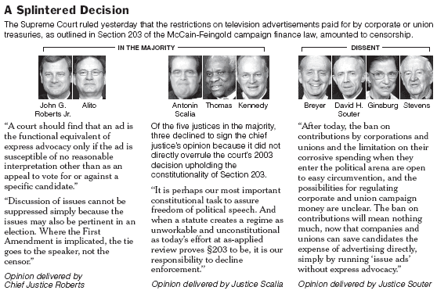
The Supreme Court Monday sided with the right-to-life group:
Notes:
June 26, 2007

Slide 64
Background Two federal appeals courts declared the federal Partial-Birth Abortion Act of 2003 unconstitutional, basing their rulings on the 2000 case of Stenberg v. Carhart. These new cases are the Bush administration's appeals of those rulings. The statute outlaws a surgical procedure that doctors use to perform abortions after about 12 weeks of pregnancy. In its decision six years ago, the Supreme Court held by a vote of 5 to 4 that the law had to take into account medical judgments that the procedure was sometimes necessary for a pregnant woman's health. Congress responded by enacting a federal law without a health exception, declaring that the procedure was never necessary to protect a pregnant woman's health.
Gonzales v. Carhart & Gonzales v. Planned Parenthood
Notes:
2006-2007 term

Slide 65
Previous Supreme Court decisions about abortion
AYOTTE v. PLANNED PARENTHOOD (2006) Does a law that restricts teenagers' access to abortion need to include an exception for medical emergencies? Yes 9 No 0
STENBERG v. CARHART (2000) Can the government prohibit doctors from performing a procedure that opponents call partial-birth abortion if the law does not contain a health exception?
No 5 Yes 4
PLANNED PARENTHOOD v. CASEY (1992) Should a constitutional right to abortion be reaffirmed?
Yes 5 No 4: The majority said the 1973 decision had acquired a "rare precedential force" and could be overturned "under fire" only "at the cost of both profound and unnecessary damage to the Court's legitimacy, and to the nation's commitment to the rule of law."
The decision upheld parts of Pennsylvania's Abortion Control Act and struck down another part, applying for the first time a new analysis that asks whether a state abortion regulation has the purpose or effect of imposing an "undue burden." This was defined as a "substantial obstacle in the path of a woman seeking an abortion before the fetus attains viability."
ROE v. WADE (1973) Do women have a constitutional right to abortion?
Yes 7 No 2
Notes:
http://www.nytimes.com/ref/washington/scotuscases_ABORTION.html
Casey : Under this analysis, the Court said that four sections of Pennsylvania's law did not impose an undue burden on the right to abortion and were constitutional. These sections require a woman to delay an abortion for 24 hours after listening to a presentation at the medical office intended to persuade them to change her mind; require teen-agers to have the consent of one parent or a judge; specify the medical emergencies in which the other requirements will be waived, and require the doctor or clinic to make statistical reports to the state. At the same time, by a 5-4 vote, the Court struck down a fifth provision requiring a married woman to tell her husband of her intent to have an abortion.

Slide 66
The Decision The Supreme Court reversed course on abortion, upholding the federal Partial-Birth Abortion Ban Act in a 5-to-4 decision that promises to reframe the abortion debate and define the young Roberts court.
The Majority
The Minority

Slide 67
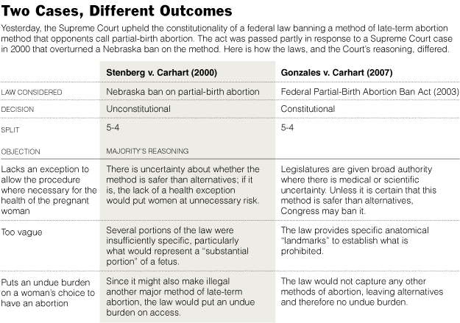

Slide 68
